Slide 1
Understanding Health and Wellness through Microbiome research
30th July – 1st August 2025
Dr. Tarini Shankar Ghosh
Microbiome Informatics
IIIT-Delhi
Day 1
Lecture 4

Slide 2
Case study using 16S data

Slide 3


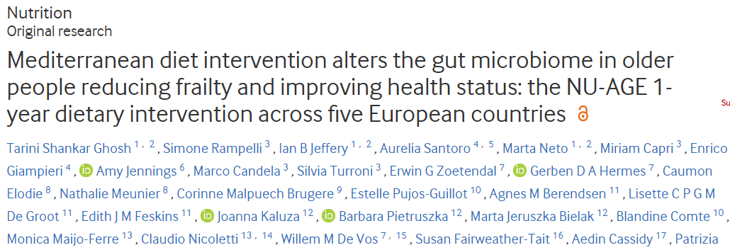
The NUAGE Mediterranean Diet Study
Gut Microbiome
Response
Improved Host Health
Diet Adherence

Slide 4


Overall flow
Mediterranean Diet
Habitual Diet
..
..
..
..
Targeted 16S sequencing
Compare
Targeted 16S sequencing
Correlate with Diet, Clinical Phenotype

Slide 5


Study Design
12 months
Control
Habitual Diet
UK
289
NED
POL
FRA
Personally
Customized
MedDiet
Intervention
ITA
323
10 Institutions
Baseline
Post
MICROBIOME
MED-DIET
COMPLIANCE
DIET INTAKE
READ-OUTS/
METADATA
SERUM
METABOLOME
Vegetable, legumes, fruits, nuts, olive oil and fish and low consumption of red meat and dairy products and saturated fats.
COGNITIVE FUNCTION
Positively associated with health.
SERUM CYTOKINE
FRAILTY INDICES
Ghosh et al Gut 2020
ANTHROPOMETRY

Slide 6
Initial examination did not reveal any link between diet adherence and health

Slide 7
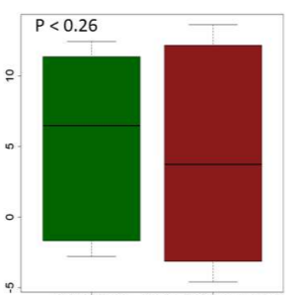
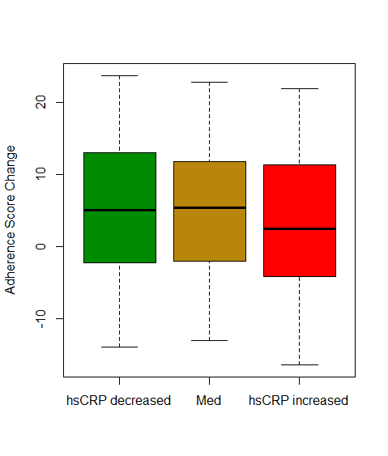
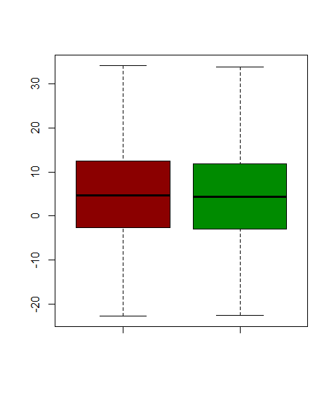
No overall difference in either physical well-being, inflammation and cognitive function with diet adherence
Frailty
Inflammation
Cognitive Function
P <= 0.07
P <= 0.87
Adherence Score Change
Reduced
Frailty
Increased/
Unchanged
Frailty
CRP decreased
NS
CRP increased
Construct.
Praxis
Decreased
Construct.
Praxis
Increased
Then we probed deeper and asked:
Is adherence to the diet associated with changes in the microbiome?

Slide 8
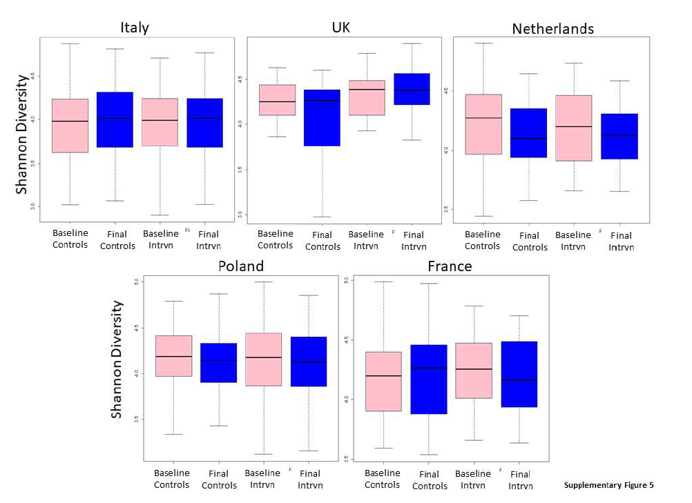
No change in richness/evenness of the gut microbiome

Slide 9
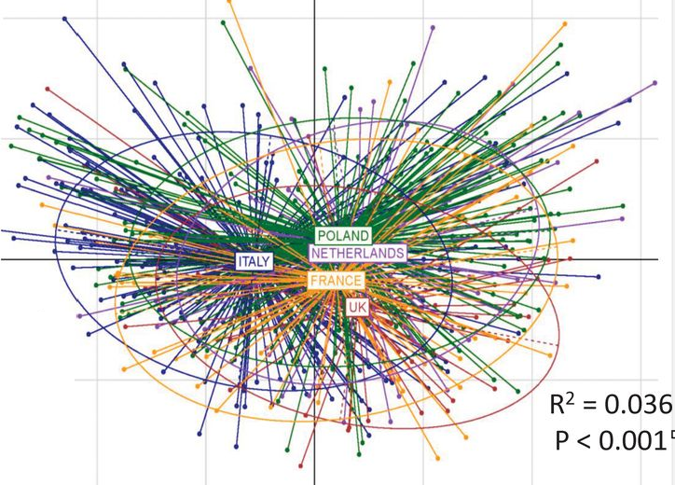
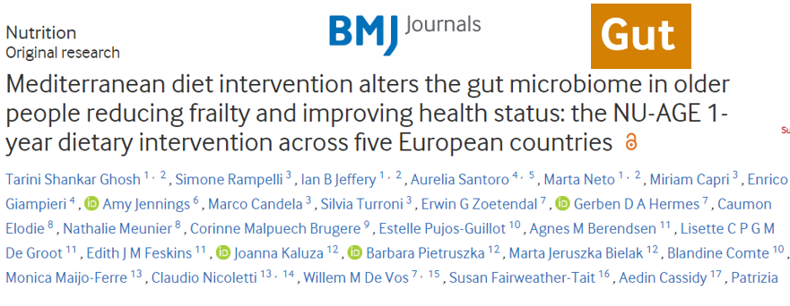
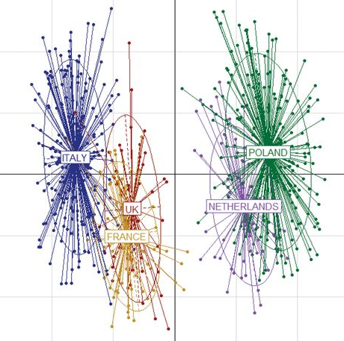
However… There was a link between the diet and the microbiome
Country of residence significantly influences microbiome composition
Compatriots have similar microbiome composition
Same thing for dietary consumption patterns
Next question: How do we check if dietary consumption patterns are associated with microbiome composition

Slide 10
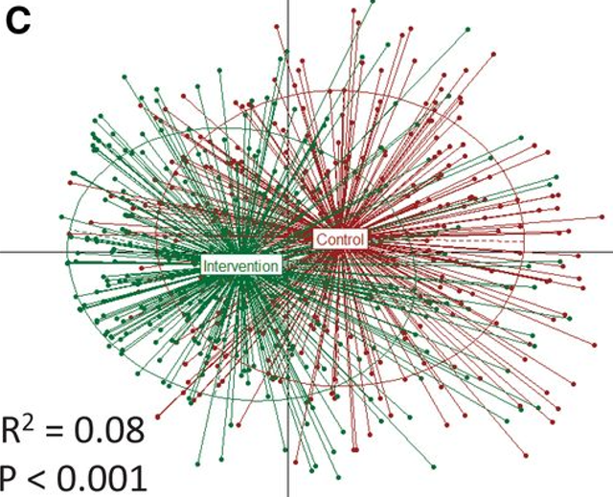
Controls had very distinct changes in their diet as compared to those in MedDiet cohort

Slide 11
Is there a link between Mediterranean Diet adherence and gut microbiome composition?
Mediterranean Diet Adherence Score: How much a person adheres to the Mediterranean Dietary Pattern?

Slide 12
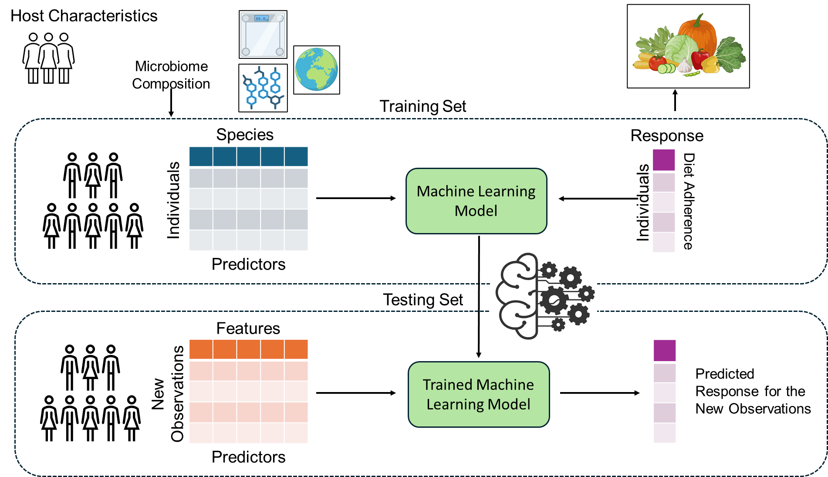
We investigated this using Machine Learning. What is this?
Learning the relationships
Predicting for new observations

Slide 13
Random Forest based Machine Learning
Has two key advantages
It can indicate how strongly the predictors are associated with response
Higher and significant Correlation between Actual and Predicted values indicate stronger relationships
It can also identify which predictors show the strongest prediction power
These are the ones that show the strongest association with response
In this example, microbes with the strongest power to predict MedDiet adherence scores are the ones that are associated most strongly

Slide 14
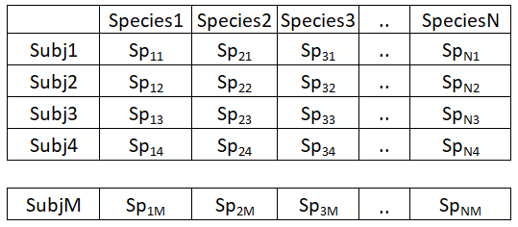
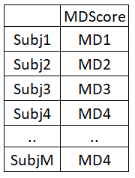
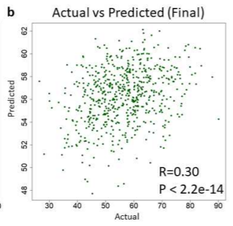
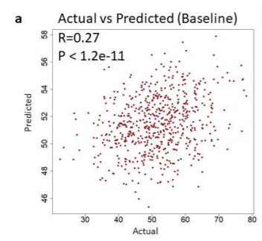
Machine-learning based identification diet-responsive gut microbiome response
Predictors
Response
Machine Learning
(Random Forest)

Slide 15
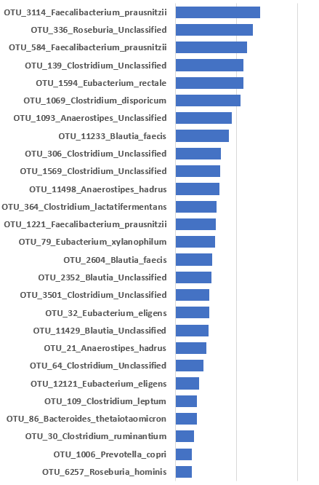
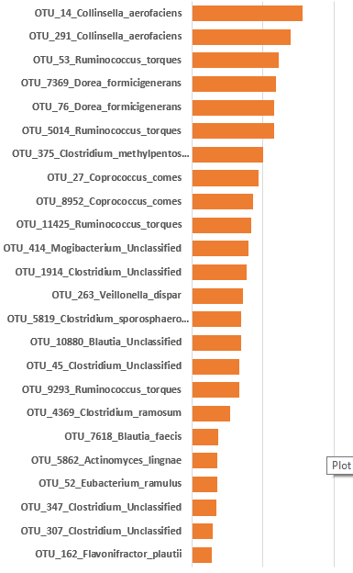
Machine-learning based identification diet-responsive gut microbiome response
Positively associated with diet
Negatively associated with diet
Microbes positively and negatively associated with adherence to MedDiet

Slide 16
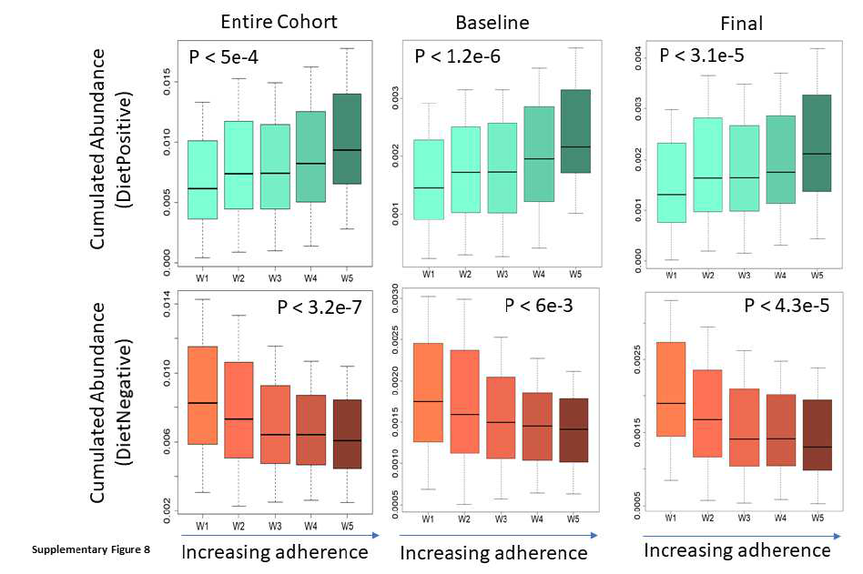
Association of Diet-associated microbes with different levels of adherence

Slide 17
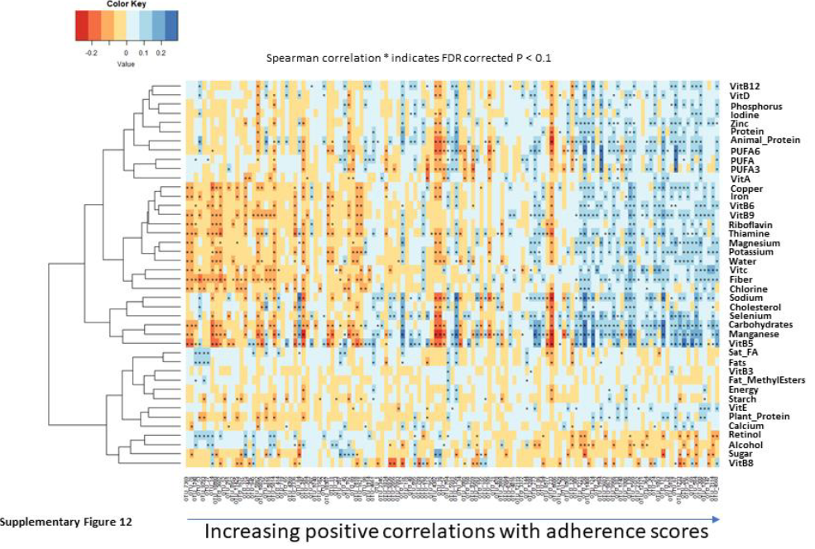
DietPositive > Positive associations with MedDiet components and vice-vera

Slide 18
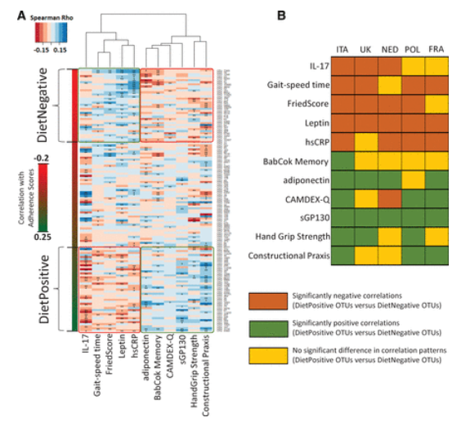
Diet responsive correlated exactly in the same manner with health as was expected of the MedDiet adherence
Diet Positive Microbes
Diet Negative Microbes
Positively influences
Negatively influences
Increased cognitive function
Reduced inflammation
Increased physical function
(Reduced Frailty)
Reduced Depression
Inflammation Frailty
Improved cognitive function, physical well-being

Slide 19
To summarize
No Association
Gut Microbiome
Response
Improved Host Health
Diet Adherence
+ve Association
+ve Association
What are the gut microbial functions that may mediate these associations with diet and health?

Slide 20
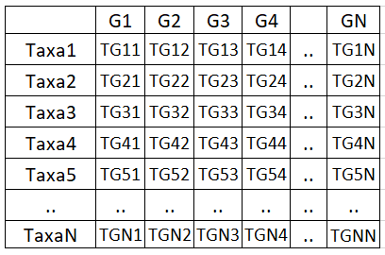
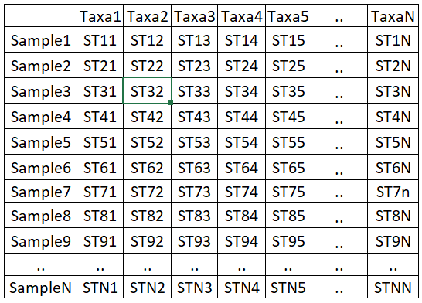
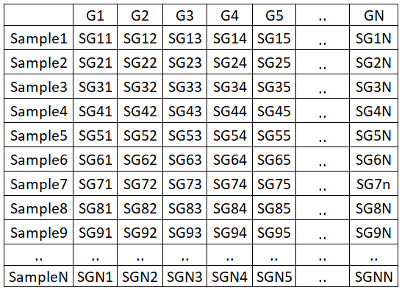
Since the data was 16S, we adopted the inferred functional approach
Using previous literature searches
Experimentally validated metabolic production and consumption patterns of 992 species
Metabolic Functions for microbiome/sample (Inferred)
Taxa Abundance
Based on Marker Genes
Samples
We know the association of each taxa with the different functions
We know what taxa are in what abundance in each sample
We infer the abundance of each metabolic function in each sample

Slide 21
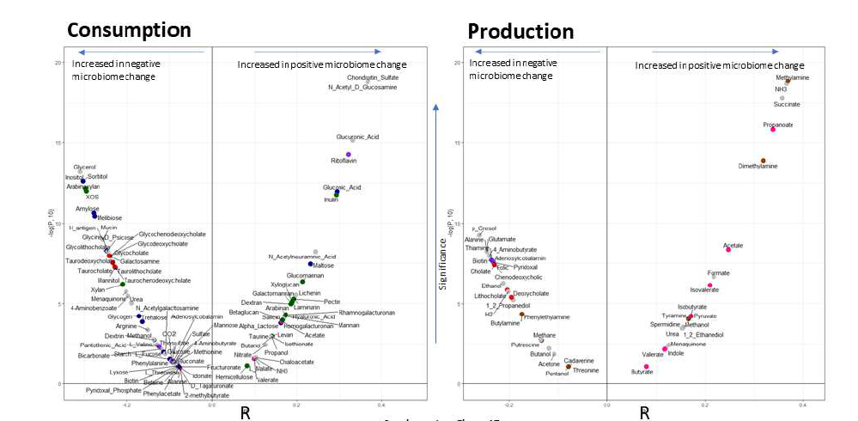
Inferred functions decipher these links
Diet associated microbiome change is associated with increase in Short Chain Fatty Acids production and decrease in TMA and hydrophobic bile acid production

Slide 22
Functional links
Positive Adherence to MedDiet
Consumption of complex carbohydrates like inulin, pectin, betaglucan, galactomannan (all previously known to have prebiotic beneficial properties associated with Mediterranean Diet
Production of SCFAs (anti-inflammatory properties, anti-cancer), GABA, Tryptophan intermediates (both linked to cognitive functions), Spermidine
Negative Adherence to MedDiet
Consumption of simple sugars
Production of TMA NH₃ (linked to Heart Disease risk), Ethanol (linked to Heart Disease risk) NH₃, p-Cresol, Acetone (Toxins)

Slide 23
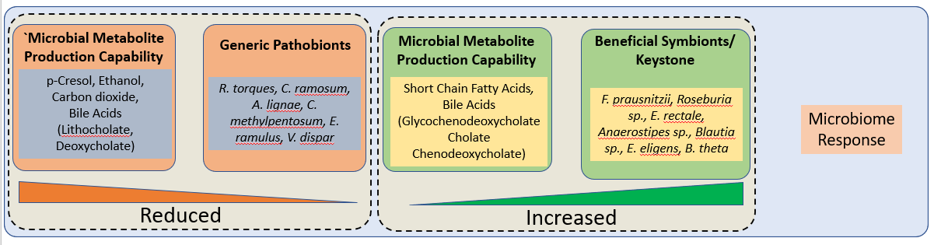
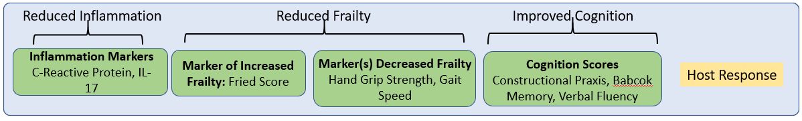
Summary: Gut microbiota as a transducer of dietary signals in an elderly host
Significant
Association
No Significant Association
Generic pathobionts
Significant
Association
Generic commensals

Slide 24
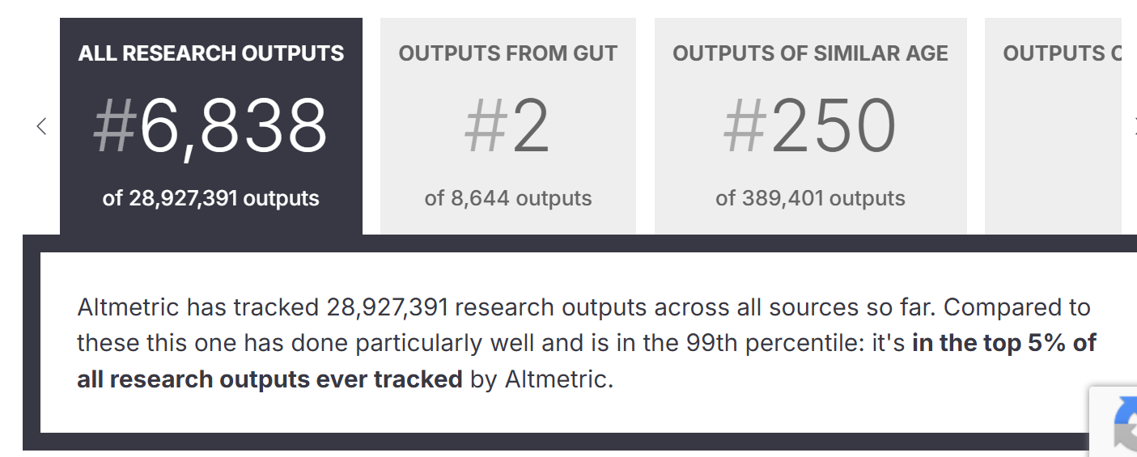
Second most accessed paper in the prestigious journal Gut
This study for the first time showed the microbiome mediated effect of the Mediterranean Diet on human health
https://bmj.altmetric.com/details/76230054#score

